Slide 1
Image and Vision Science.
Alan Yuille: (Statistics, UCLA)
Joint: Computer Science, Psychiatry, Psychology
Co-Director: Center for Image and Vision Sciences (UCLA)
Education: Mathematics, Theoretical Physics

Slide 2
Interests:
Computer Vision: understanding/parsing natural images (cameras, videos).
Machine Learning.
Computational Neuroscience.
fMRI/EEG (M. Cohen).
Medical Image Processing.
Random: detecting particles in high energy physics accelerators.

Slide 3
Vision as Probabilistic Inference.
Example Tasks:
Image Segmentation
Image Labeling
Object Detection and Recognition
Object Parsing
Motion Estimation
Image Parsing

Slide 4
Three Examples
(1) Image Labeling: Segmentation and Object Detection.
Datasets: MSRC, Pascal VOC07.
(2) Object Category Detection.
Datasets: Pascal 2010, Pascal 2007
(3) Multi-Class,-View,-Pose.
Datasets: Baseball Players, Pascal, LableMe.

Slide 5
Basic Ideas
Probability Distributions defined over structured representations.
General Framework for all Intelligence?
Graph Structure and State Variables. Knowledge Representation.
Probability Distributions.
Computation:
Inference Algorithms.
Learning Algorithms.

Slide 6
Probability Distribution
X: input image.
Y State Variables of all nodes of the Graph:
Energy E(x,y) contains:
(i) Prior terms – relations between state variables Y independent of the image X.
(ii) Data terms – relation between state variables Y and image X.

Slide 7
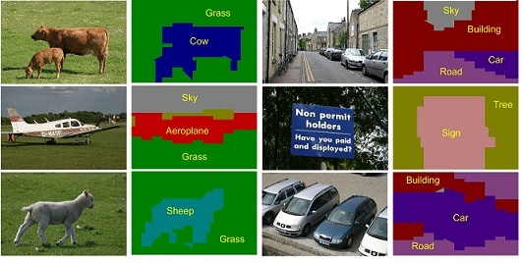
Example (1): Image Labeling
Task: Image Segmentation and Labeling.
Microsoft (and PASCAL) datasets.

Slide 8
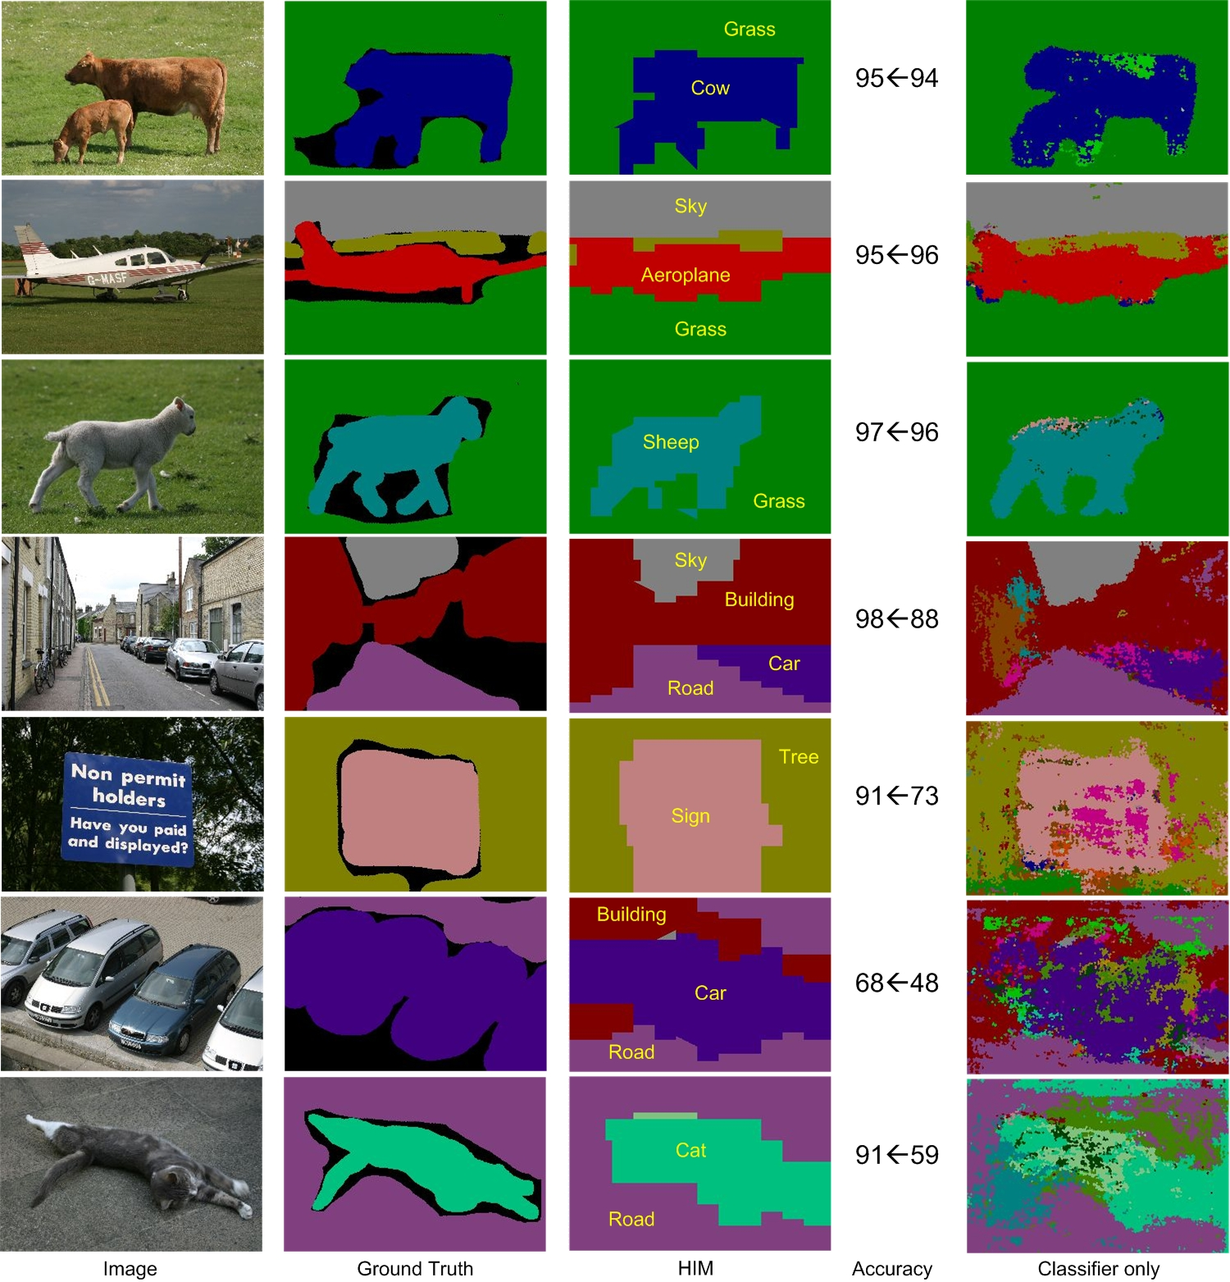

Slide 9
Performance
MSRC – Global 81.2%, Average 74.1%
(state-of-art in CVPR 2008).
Note: with lowest level only (no hierarchy):
Global 75.9%, Average 67.2%.
Note: accuracy very high approx 95% for certain classes (sky, road, grass).
Hierarchical Graphical Models. Inference by Dynamic Programming. Learning by Structure Perceptron.

Slide 10
Example (2): Object Detection
Input: set of images with boxes round the positions of objects.
Task: detect and label the objects.
Inference by Dynamic Programming.
Learning by Latent Support Vector Machines.

Slide 11
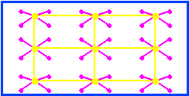
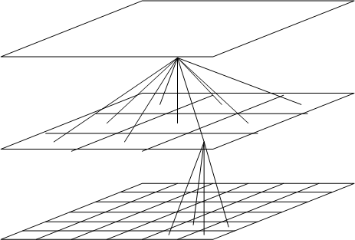
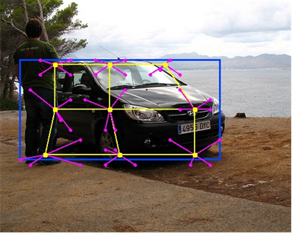
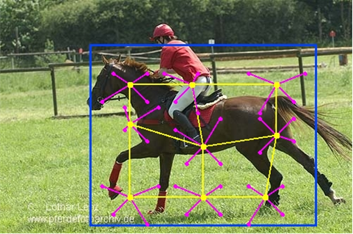
Graph Structure:
The parts can move relative to each other enabling spatial deformations.
Constraints on deformations are imposed by edges between parents and child (learnt).
Parent-Child spatial constraints
Parts: blue (1), yellow (9), purple (36)
Deformations of the Car
Deformations of the Horse
Notes:
The parts can move relative to each other allowing for spatial deformations of the object. Spatial constraints on these deformations will be learnt. We give two examples to illustrate these deformations representing the top, middle, and lower level parts by blue, yellow, and purple squares respectively.

Slide 12
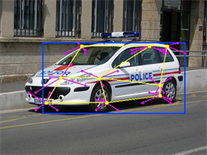
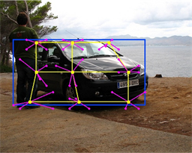
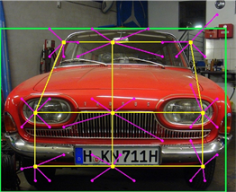
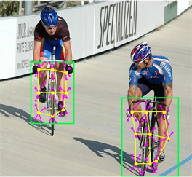
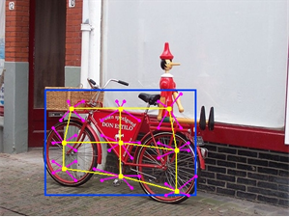
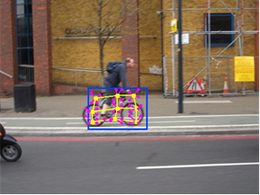
Multiple Models: Pose/Viewpoint:
Each object is represented by 4 or 6 hierarchical models (mixture of models).
These mixture components account for pose/viewpoint changes.
Notes:
Each object is represented by 4-6 hierarchical models – i.e. a mixture of models. The mixture components – each a hierarchical model – allow us to deal with different poses of the object, as illustrated in these figures.

Slide 13
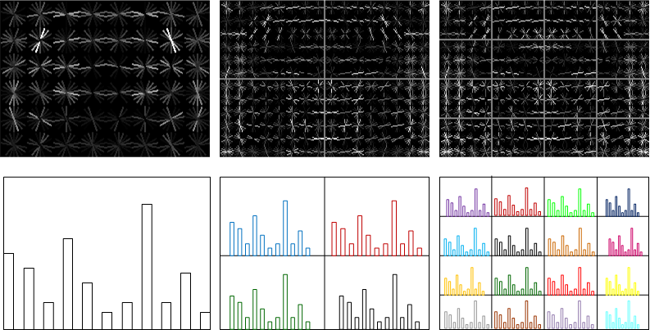
Image Features: HOGs and HOWs
Edge-like: Histogram of Oriented Gradients (Upper row)
Regional: Histogram Of Words (Bottom row)
13950 HOGs + 27600 HOWs
Notes:
The HOG and the HOW potentials. The upper row illustrates the HOG potentials for a car (after the weights have been learnt). The bottom row shows the HOW histograms for some of the parts.

Slide 14
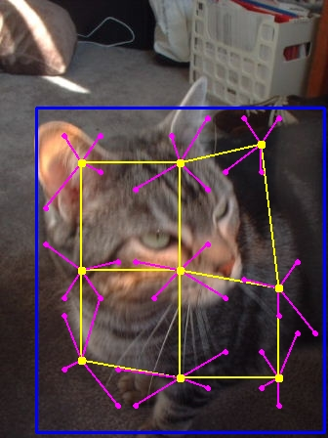
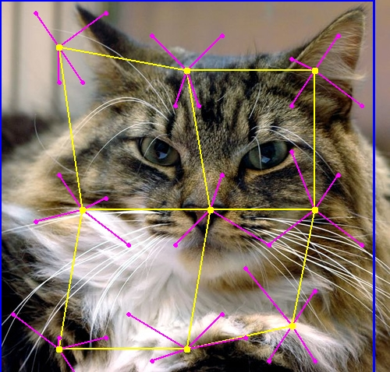
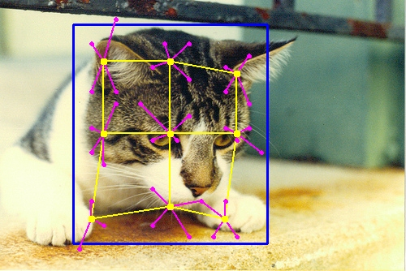
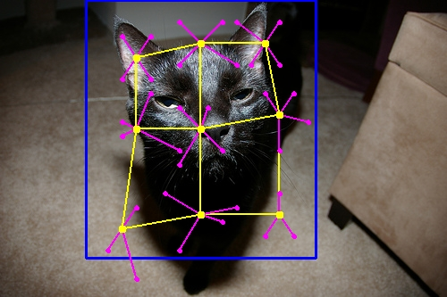
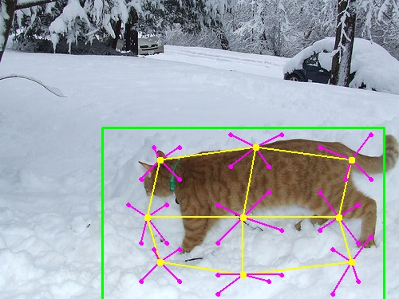
Detection Results on PASCAL 2010: Cats
Notes:
The blue/green rectangles show the bounding boxes. Different mixture hierarchical models account for pose changes. The yellow grids visualize the deformations.

Slide 15
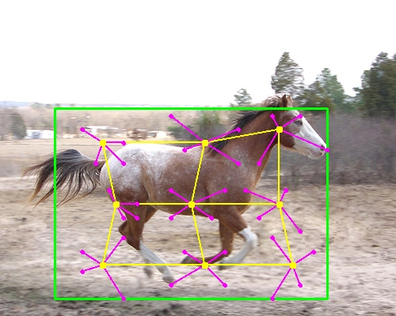
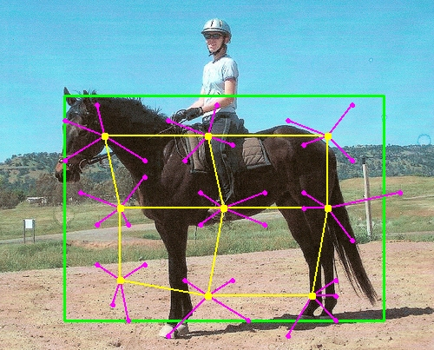
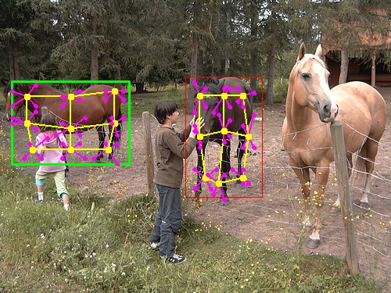
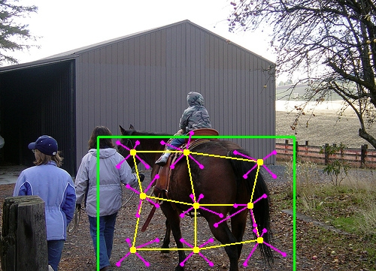
Horses
Notes:
In this case, the heads of horses are consistently aligned in different images. The detector misses one horse in the bottom-left image.

Slide 16
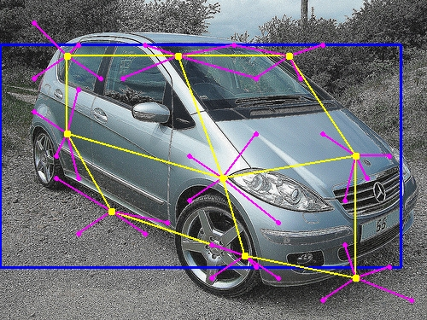
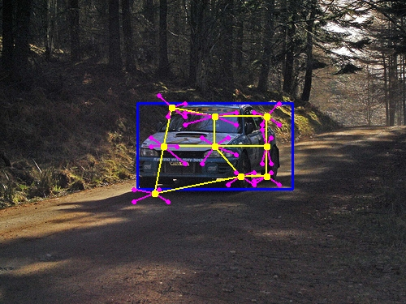
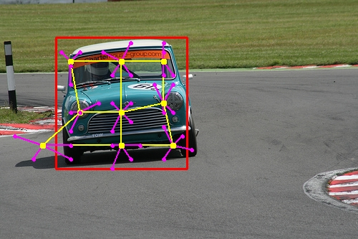
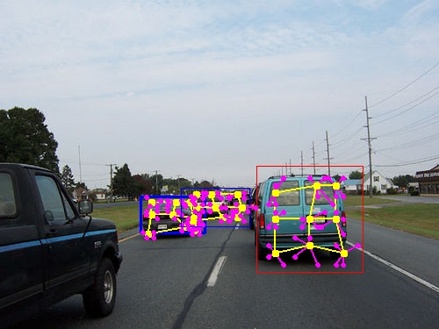
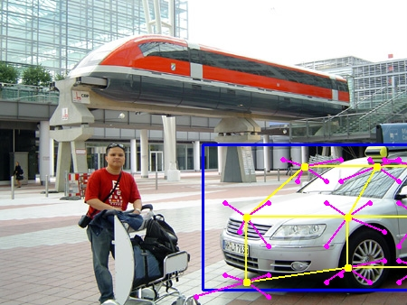
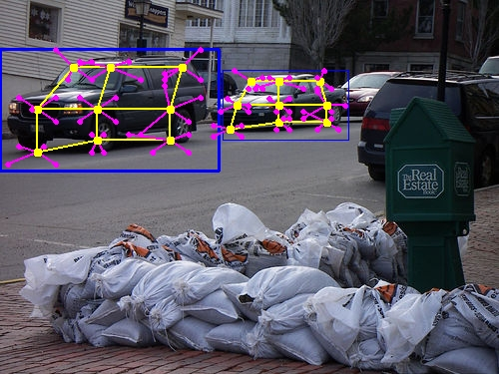
Cars
Notes:
Occlusion happens in the bottom-middle image.

Slide 17
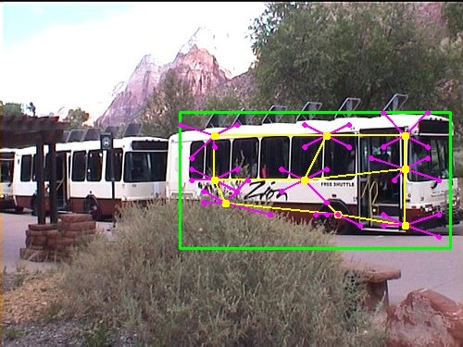
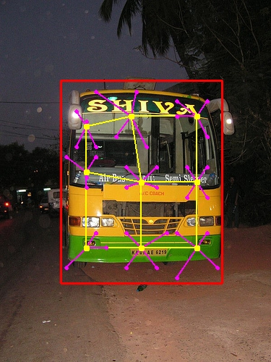
Buses
Notes:
More examples.

Slide 18
Comparisons on PASCAL 2010
Mean Average Precision (mAP).
Compare AP’s for Pascal 2010 and 2009.
Methods (trained on 2010) | MIT-UCLA | NLPR | NUS | UoCTTI | UVA | UCI
Test on 2010 | 35.99 | 36.79 | 34.18 | 33.75 | 32.87 | 32.52
Test on 2009 | 36.72 | 37.65 | 35.53 | 34.57 | 34.47 | 33.63
Notes:
This table shows the comparisons of several methods submitted to PASCAL 2010.

Slide 19
Example 3
Brief sketch of compositional models with shared parts.
Motivation – scaling up to multiple objects/viewpoints/poses.
Efficient representation, learning, and inference.
Zhu, Chen, Lin, Lin, Yuille (2008, 2011).
Zhu, Chen, Torrabla, Freeman, Yuille (2010).

Slide 20
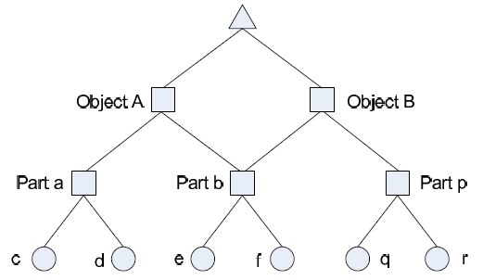
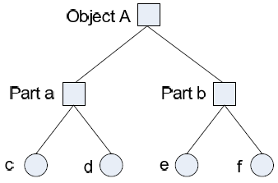
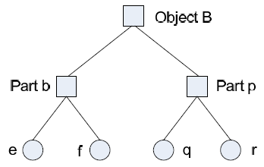
Key Idea: Compositionality
Objects and Images are constructed by compositions of parts – ANDs and ORs.
The probability models for are built by combining elementary models by composition.
Efficient Inference and Learning.

Slide 21
Why compositionality?
(1). Ability to transfer between contexts and generalize or extrapolate (e.g. , from Cow to Yak).
(2). Ability to reason about the system, intervene, do diagnostics.
(3). Allows the system to answer many different questions based on the same underlying knowledge structure.
(4). Scale up to multiple objects by part-sharing.
“An embodiment of faith that the world is knowable, that one can tease things apart, comprehend them, and mentally recompose them at will.”
“The world is compositional or God exists”.

Slide 22
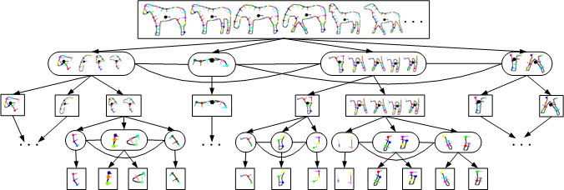
AND/OR Graphs for Horses
Introduce OR nodes and switch variables.
Settings of switch variables alters graph topology – allows different parts for different viewpoints/poses:
Mixtures of models – with shared parts.

Slide 23
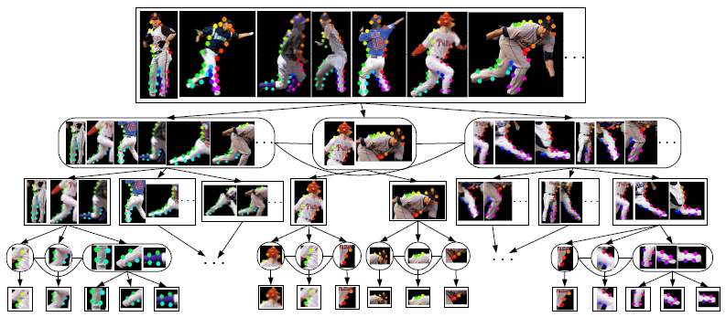
AND/OR Graphs for Baseball
Enables RCMs to deal with objects with multiple poses and viewpoints (~100).
Inference and Learning as before:

Slide 24
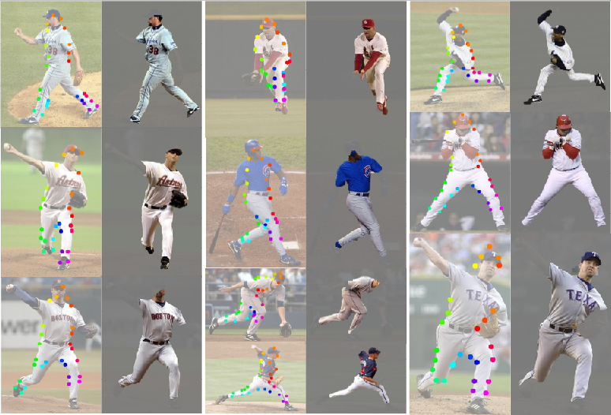
Results on Baseball Players:
State of the art – 2008.
Zhu, Chen, Lin, Lin, Yuille CVPR 2008, 2010.

Slide 25
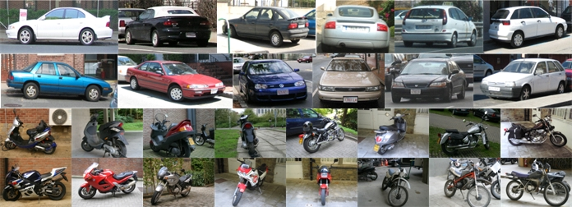
Part Sharing for multiple objects
Strategy: share parts between different objects and viewpoints.

Slide 26
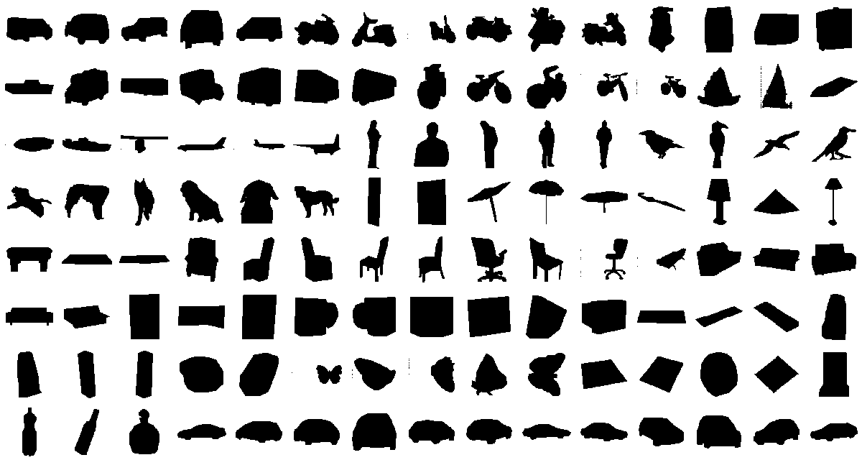
Many Objects/Viewpoints
120 templates: 5 viewpoints & 26 classes

Slide 27
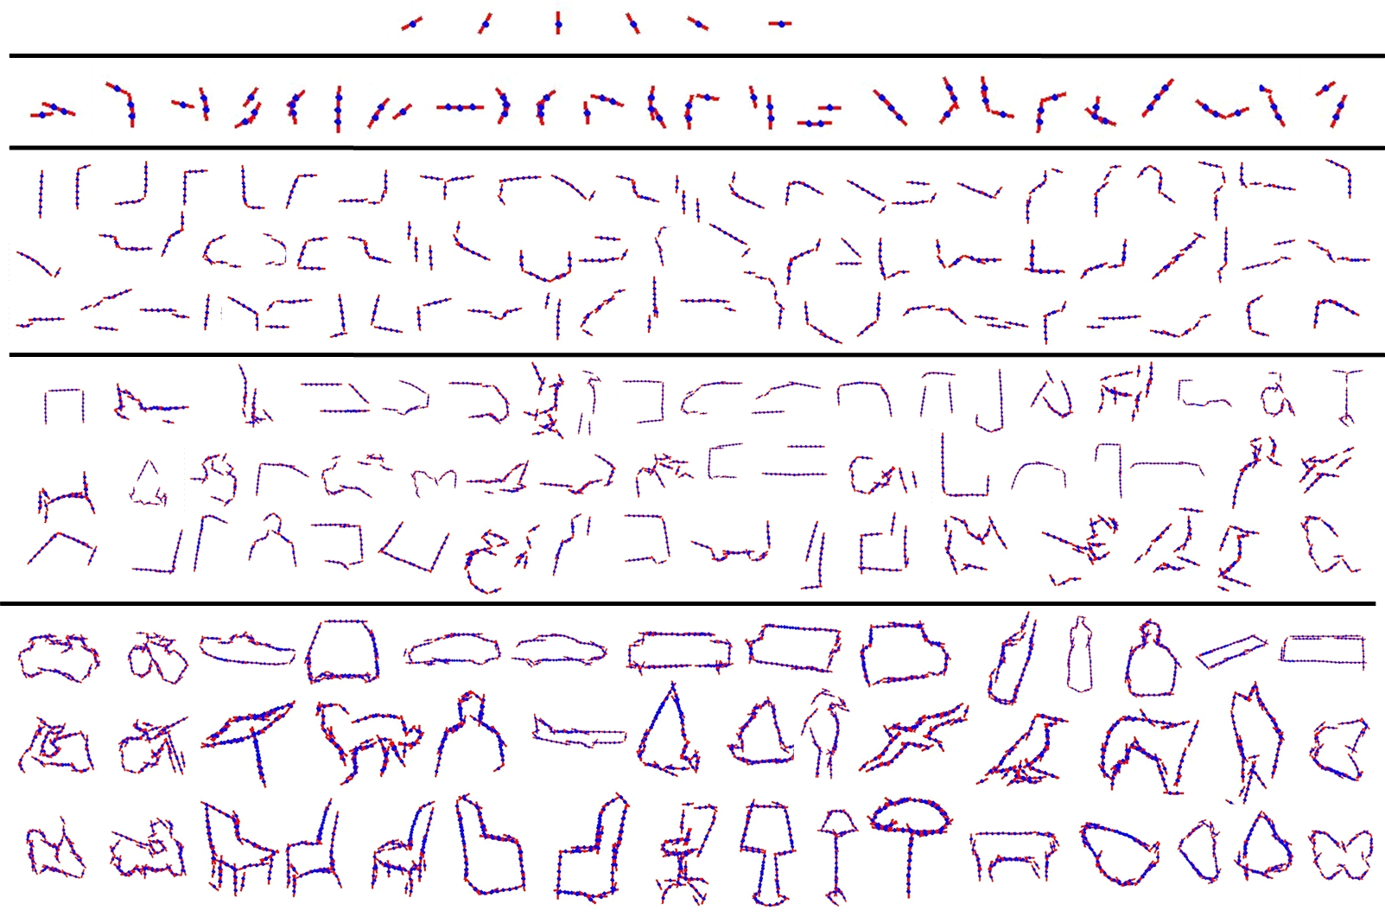
Learn Hierachical Dictionary.
Low-level to Mid-level to High-level.
Learn by suspicious coincidences.

Slide 28
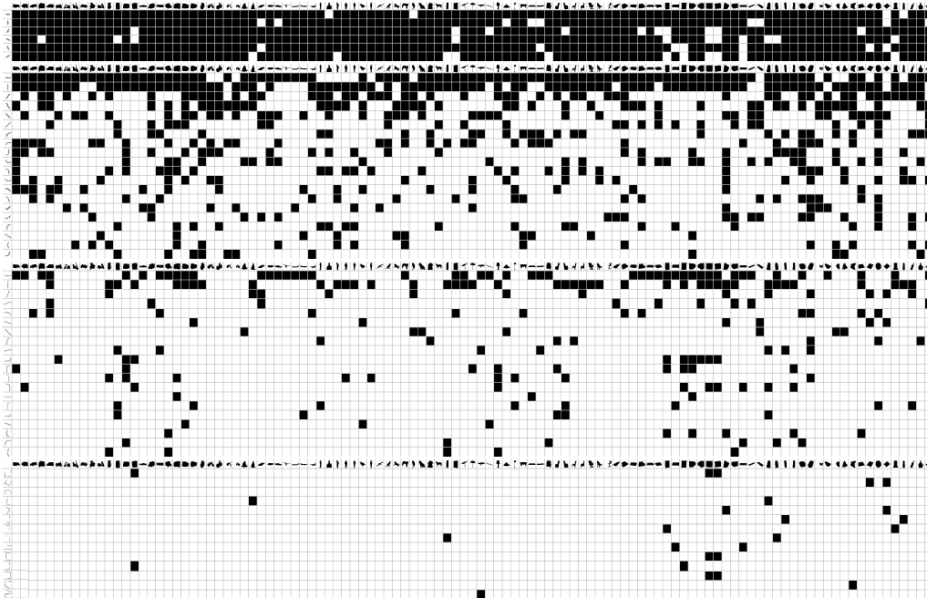
Part Sharing decreases with Levels

Slide 29
Mammalian Visual Cortex
How do these models relate to the human/monkey visual cortex?
These models are hierarchical – for representation reasons – which may relate to hierarchical structure of monkey/human visual cortex.
They relate to ‘standard models’ like Poggio’s?
How can these models be tested?
Pre-history: Koch, Marroquin, Yuille (1987)

Slide 30
Some Proposed Work
Collaboration with Tai Sing Lee (CMU).
Multi-electrode recordings.
Use statistical methods to relate neural populations to dictionaries of image stimuli.
Model-driven – hypothesize that neural populations are tuned to visual concepts learnt from the environment.
Data-driven – use machine learning to learn neural population responses.
(Dynamics?)

Slide 31
Grant Ideas
Computational Photography – needs to be mentioned. Imaging and Enhancing.
Photometric Stereo – get depth with fixed camera and illumination from several directions.

Slide 32
Techniques Used
Probabilistic Formulation:
Generative or Discriminative
Gibbs distributions – relate to energy functions.
Learning: learn these distributions – supervised or unsupervised.
Inference: estimate the most probable interpretations.

Slide 33
Inference Algorithms:
Steepest Descent/Level Sets/Split Bregman
Dynamic Programming.
Min-Cut/Max-Flow.
Convex Optimization.
Variational Methods (e.g. MFT)
Belief Propagation
Spectral Methods (normalized cuts)

Slide 34
Pattern Recognition and
Machine Learning
Principal Component Analysis
K-means/Clustering
Nearest Neighbours.
AdaBoost
Support Vector Machines
Structure Perceptron and Max-Margin
Latent SVM (w. hidden variables)
Independent Component Analysis
Sparse Coding
Nonlinear Dimension Reduction (Spectral)

Slide 35
Statistical/Probabilistic Methods
Probabilistic Models on Graphs:
Markov Random Fields (MRFs)
Hidden Markov Models (HMMs)
Stochastic Grammars And/Or Graphs
Topic Models/Deep Belief Networks.
Regression/Non-linear Regression/GLIM
Stochastic Descent
Expectation-Maximization
Markov Chain Monte Carlo (MCMC)
Temporal: Bayes-Kalman/Particle Filters

Slide 36
Geometry + Lighting Models
Geometry of Projection
Perspective Geometry
Structure from Multiple Viewpoints
Diffeomorphisms/Warping
Riemannian Geometry
Lambertian Lighting Models
Bi-Directional Reflectance Functions
Specularities
Cast and Attached Shadows
Shape from Shading/Photometric Stereo

Slide 37
Filters/Features
Edge Detectors
Interest Point Detectors
SIFTs and HOGs
Filterbanks/Wavelets
Morphology
Dictionaries
Affinity Measures.
Texture Models.

Slide 38
Additional Background
Information Theory
Entropy/Information/Encoding
Optimization Theory
Primal/Dual Formulations
Multi-Grid/Multi-Scale
Calculus of Variations.

Slide 39
References
See http://www.stat.ucla.edu/~yuille/

